Slide 1
Brand Reputation Tracker Wireframe
July 2018

Slide 2

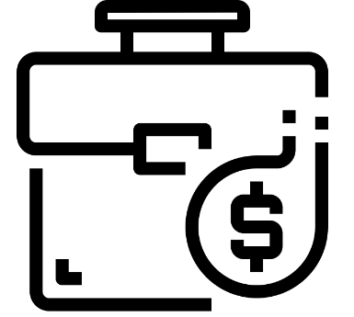

Overview
Financial Reports
Social Media
Analyst Reports
Brand Reputation
Financial Score
Non-Financial Score
Perception Score
Popularity Score
Demand Analysis
Perception Impact Factor
Popularity Impact Factor
Perception Score
Popularity Score
Perception Impact Factor
Popularity Impact Factor

Slide 3







Brand Reputation Wireframe – Aggregated Scores
Brand Reputation Tracker
Brand
Health
Brand
Health
Brand
Health
Brand
Health
Financial Scores Perception Score: 30
Popularity Score: 60
Financial Scores Perception Score: 35
Popularity Score: 50
Financial Scores Perception Score: 30
Popularity Score: 50
Financial Scores Perception Score: 40
Popularity Score: 45
Non-Financial Scores Perception Score: 50
Popularity Score: 70
Non-Financial Scores Perception Score: 50
Popularity Score: 70
Non-Financial Scores Perception Score: 50
Popularity Score: 70
Non-Financial Scores Perception Score: 50
Popularity Score: 70

Slide 4
Brand Reputation Wireframe – ASI Top Trends
Brand Reputation Tracker
Brand Health
Brand Health
Brand Health
Brand Health
Top Themes / Topics
Post Brexit policies
Aberdeen SLI Merger
Ryder Cup
….
Top Financial Products/Categories
UK Equity Income
MyFolio
GARS Performance
…
View More
View More

Slide 5
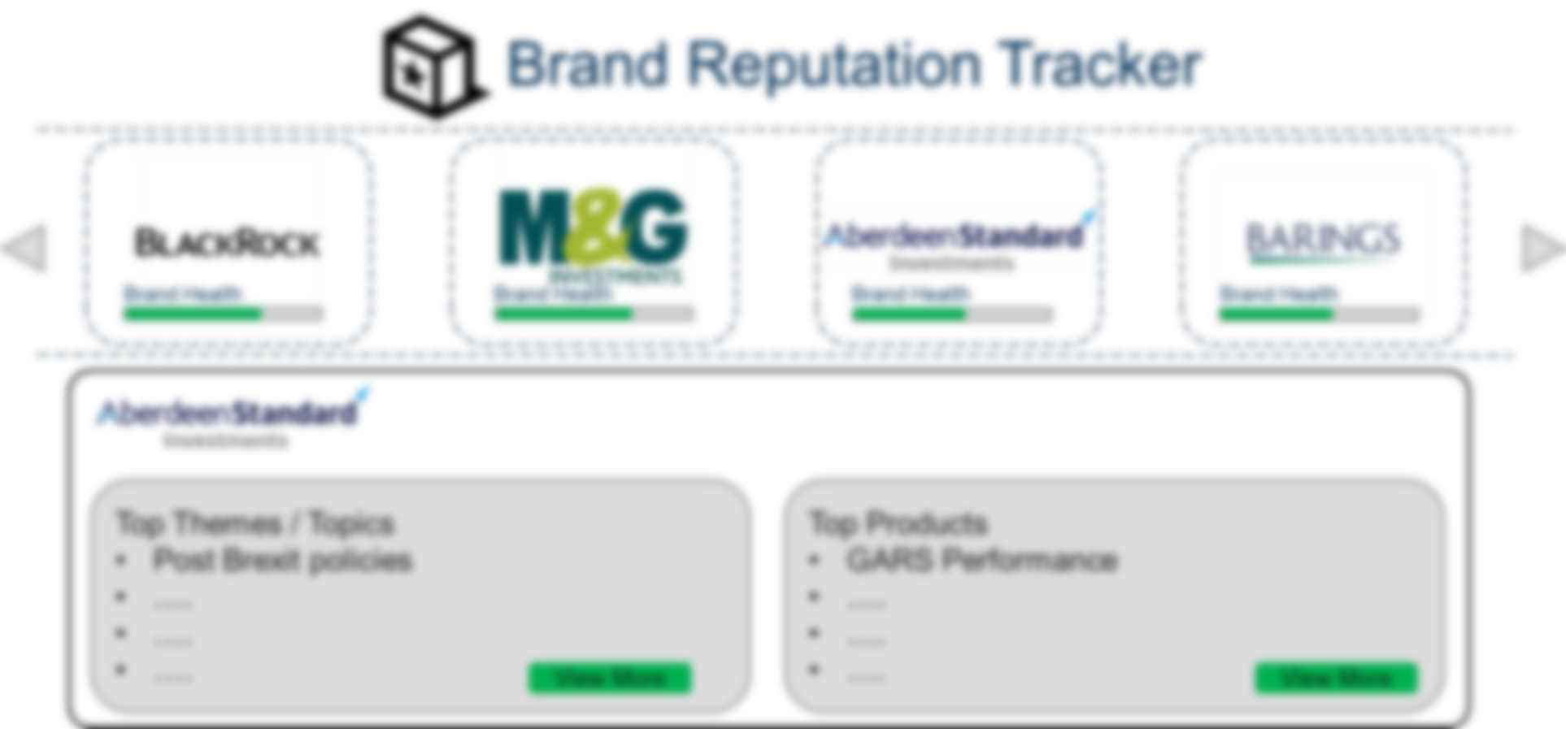



Brand Reputation Wireframe – Category level
UK Equity Income
Demand Analysis
Popularity Impact Factor
Perception Impact Factor
Popularity vs Sales Matrix
Popularity
Analyst Ratings | Buy | Hold | Sell
Q1 | 100 | 50 | 50
Q2 | 80 | 80 | 40
Q3 | 75 | 85 | 40
Q4 | 80 | 65 | 55
Sales
Correlating Popularity measures with Sales. Measuring the degree or impact a particular theme or sentiment has in sales of a product or class of products. An Demand Analysis measures the popularity of a product and class of product in the industry and compares the sales within ASI with the in-industry demand, and helps by providing a benchmarks that can help business.
Back

Slide 6



Brand Reputation Wireframe – Category level
UK Equity Income
Demand Analysis
Popularity Impact Factor
Perception Impact Factor
Popularity Trends
Reach
Engagement
Resonance
Popularity
Social
Media
15K
8K
1K
Persistent Trend
Analyst
Reports
30K
6K
2K
Medium Impact
News
20K
10K
3K
Short Term Buzz
Measures the rate of decline of a particular theme/topic in a 12/24 month window frame. Helps classify the popularity into three buckets 1. Short term Buzz 2. Medium term Impacts 3. Persistent trends
This can help understand the lifecycle of each popular theme/ topic that influences specific market trends.
Time-period
Back

Slide 7
Brand Reputation Wireframe – Category level
UK Equity Income
Demand Analysis
Popularity Impact Factor
Perception Impact Factor
Sentiment Trends
Perception Score
Perception
Social
Media
Positive Sentiment
80
Negative Sentiment
20
Negative Sentiment
Analyst
Reports
Positive Sentiment
70
Negative Sentiment
30
Positive Sentiment
News
Positive Sentiment
75
Negative Sentiment
25
Neutral Sentiment
Perception Impact Factor:
The degree of relevance of the perception on a theme or topic on today’s themes. Perception of an old theme/topic can persist over a period and can have direct impact on today’s themes in various media. Alternatively prior perception could have triggered newer themes/topics that have relevance on current sources of media. The perception impact factor measure the relevance of prior themes and helps understand their decline or transformation.
Time-period
Back

Slide 8
Brand Reputation Wireframe – ASI Top Trends
Brand Reputation Tracker
Brand Health
Brand Health
Brand Health
Brand Health
Top Themes / Topics
Post Brexit policies
Aberdeen SLI Merger
Ryder Cup
….
Top Financial Products/Categories
UK Equity Income
MyFolio
GARS Performance
…
View More
View More

Slide 9
Brand Reputation Wireframe – Top themes
Filters:
Financial Products/Categories
Sort:
By Popularity Score
Search Bar
Ascending
Themes / Topics
Descending
By Perception Score
Item | Deep-Dive | Popularity Score | Perception Score
Post Brexit policies |  | #### | ####
Aberdeen SLI Merger |  | #### | ####
Ryder Cup |  | #### | ####
…
…
…
Analyse
Analyse
Analyse
Home

Slide 10
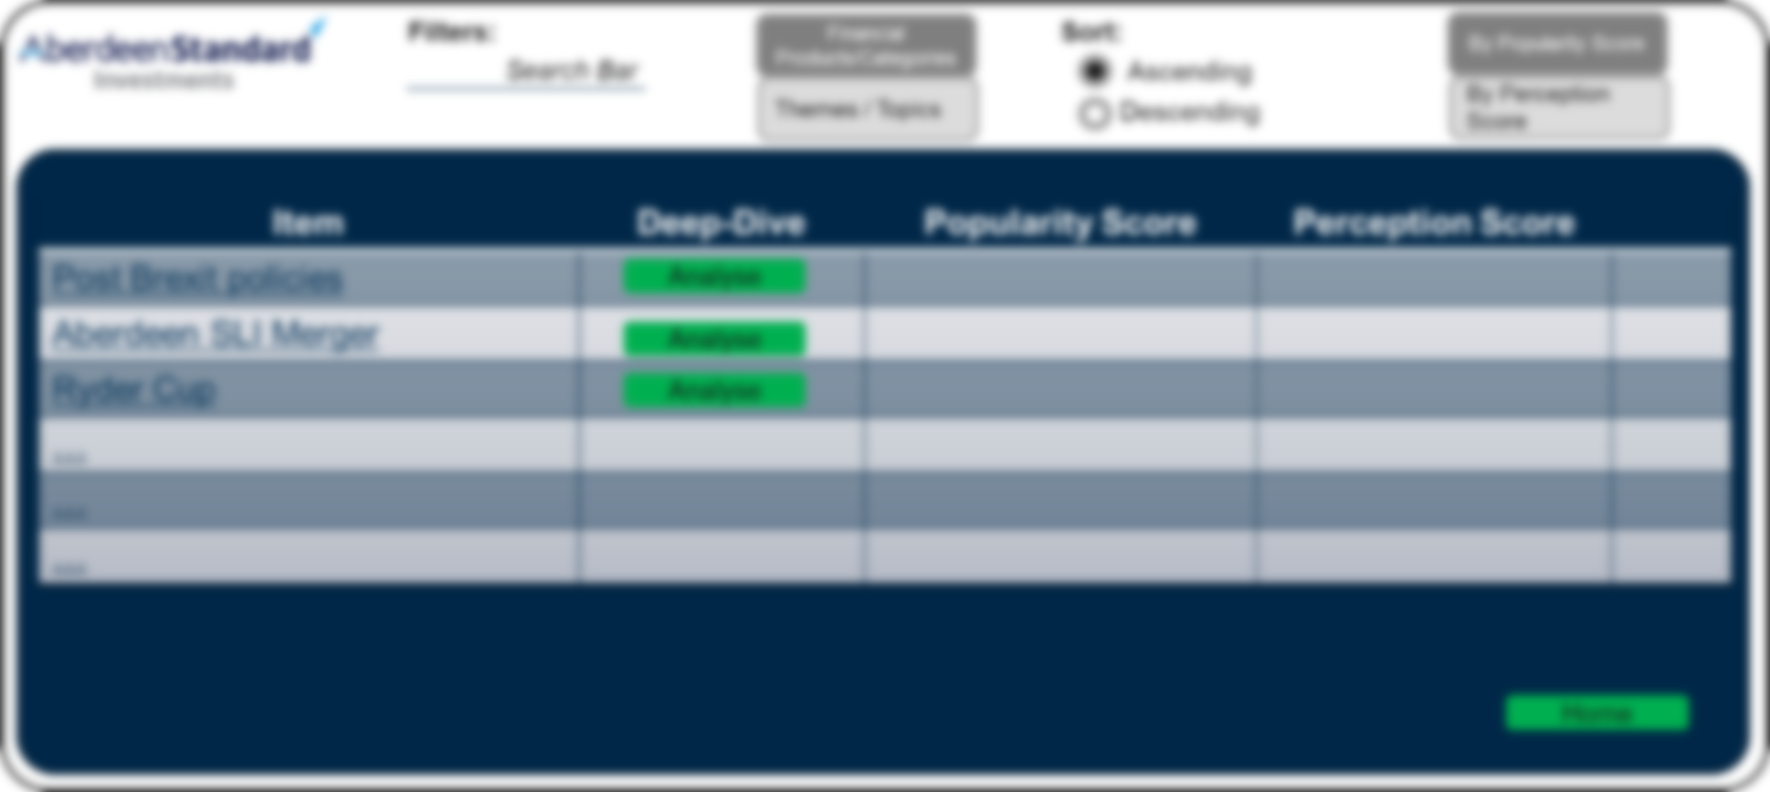
Brand Reputation Wireframe – Category level
All Competitors
ASI
Dismiss

Slide 11
Brand Reputation Wireframe – Category level
Filters:
Financial Products/Categories
Sort:
By Popularity Score
Search Bar
Ascending
Themes / Topics
Descending
By Perception Score
Item | Deep-Dive | Popularity Score | Perception Score
Post Brexit policies |  | #### | ####
Aberdeen SLI Merger |  | #### | ####
Ryder Cup |  | #### | ####
…
…
…
Analyse
Analyse
Analyse
Home

Slide 12
Brand Reputation Wireframe – Theme Analysis
Post Brexit Policies
Demand Analysis
Popularity Impact Factor
Perception Impact Factor
Sentiment Trends
Perception Score
Perception
Social
Media
Positive Sentiment
80
Negative Sentiment
20
Negative Sentiment
Analyst
Reports
Positive Sentiment
70
Negative Sentiment
30
Positive Sentiment
News
Positive Sentiment
75
Negative Sentiment
25
Neutral Sentiment
Perception Impact Factor:
The degree of relevance of the perception on a theme or topic on today’s themes. Perception of an old theme/topic can persist over a period and can have direct impact on today’s themes in various media. Alternatively prior perception could have triggered newer themes/topics that have relevance on current sources of media. The perception impact factor measure the relevance of prior themes and helps understand their decline or transformation.
Time-period
Back

Slide 13
Implementation Plan
Phase | Deliverable | Duration | Resources
Phase I | Data Preparation, Processing, Insights - Deck | Aug – Sep (8 weeks) | 2
Phase II | Automated tool with features of Phase I | Oct – Mid Nov (6 weeks) | 1
Phase III | Tool with all the features as available in this deck | Oct – Dec (12 weeks) | 3

